Slide 1
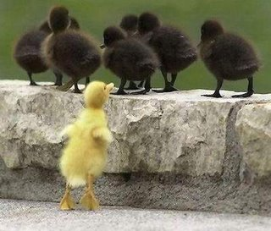
SC1101E WEEK 6
RACE & ETHNICITY
Kelvin Low Department of Sociology National University of Singapore

Slide 2
Outline
Problematising Race and Ethnicity
Key concepts
Racial/Ethnic Violence
Theories of Race and Ethnicity
Race in Singapore

Slide 3
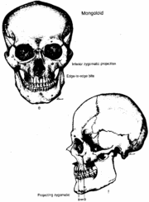
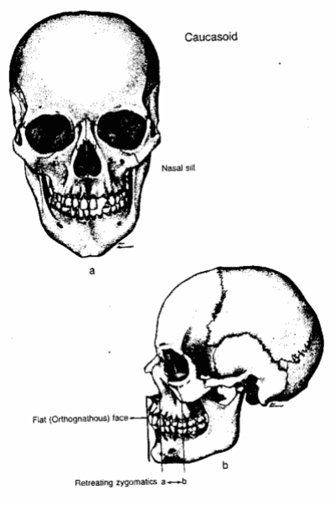
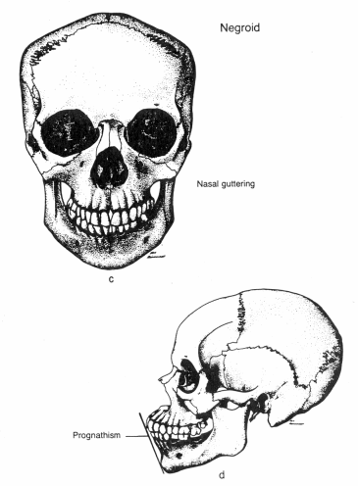
I. Problematising Race & Ethnicity
Historical classification of race: ‘Mongoloid’, ‘Caucasoid’, ‘Negroid’, and ‘Australoid’
Mongoloid
Caucasoid
Negroid

Slide 4
I. Problematising Race & Ethnicity
Other ‘racial’ classifications
Jews, Hindus –
Aryan, Latin –
English (British), Germans -
Religious groups
Language families
Nationalities

Slide 5
I. Problematising Race & Ethnicity
Comprising a group of people who are perceived to share biological traits
Problem 1 : Exceptions? Inconsistent characteristics?
Problem 2 : Samuel G. Morton (p.277-278)
Distinguishing skulls of white and black people by their shapes
Small, unrepresentative sample: 72 specimens (random/access)
Sex
Notes:
Results cannot be generalised.

Slide 6
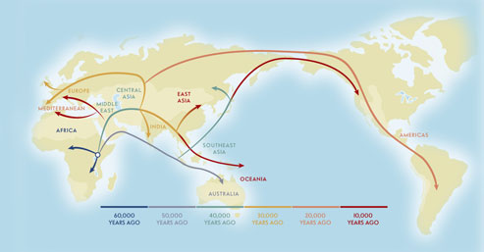
I. Problematising Race & Ethnicity
Problem 3 : ‘Out-of-Africa’ theory

Slide 7
I. Problematising Race & Ethnicity
Problem 4 : No universal definition of race
South Africa: Black, White, Coloured, and Indian
England/Ireland: Black is used to refer to all people who are not White
Singapore: C.M.I.O.
Notes:
Why then we define race?

Slide 8
I. Problematising Race & Ethnicity
Why are sociologists concerned about a concept that has little scientific accuracy and is ill defined?
Social reality: People are defined or define themselves as belonging to a group based in part on physical appearance
Race is important because of the social meanings people have attached to it
Race matters because it allows social inequality to be created and maintained
Notes:
We treat one another differently due to race.

Slide 9
II. Key concepts
‘Race’ as a category that is socially constructed
The characteristics that a society selects to distinguish one racial group from another shape social rankings and determine access to important resources
Social construct - Shapes the way we see others and ourselves; therefore, racial categories are not natural, biological categories (e.g. PuruShotam 1998)
Examples of race as a social construct
Irish and Jews regarded as ‘blacks’ (p.282)
Northern vs Southern Italians (p.282)
Notes:
Race is not a natural category. Southern Italians are regarded as lowly as compared to Northern Italians, and there is a different judgement due to differences in colours.

Slide 10
II. Key concepts
Race – perceived genetic or physical characteristics
Skin colour
Eye colour
Hair texture
Facial features
Ethnicity – refers to cultural traits
Nation of origin/ common ancestry
Food
Clothing
Language
Religion

Slide 11
II. Key concepts
Ethnicity
Ethnic Group
Ethnic Identity
an analytical concept in social science to mean a culturally-constituted group or community
perceived cultural markers are deemed socially significant and different or distinctive from others; share a common culture
the extent to which one identifies with a particular ethnic group; sense of belonging
Notes:
Cultural markers: Religion..ect which brings upon a identity.

Slide 12
II. Key concepts
Sociological use of these concepts (Ethnicity, Ethnic Group, Ethnic Identity)
Focuses on culture and the construction of differences
Focuses on mechanisms, processes by which ethnic boundaries are maintained or crossed
Ethnic boundaries are not absolute
Focuses on relations between ethnic groups in social, economic, and political contexts
Notes:
Crossing of ethnic groups is possible through marriages between ethnic group.

Slide 13
Minority Group
II. Key concepts
A social group that is singled out for differential treatment or discrimination due to physical (racial) or cultural (ethnic) differences
Traditionally been disadvantaged or experienced less access to resources
Also known as ‘subordinate groups’ in society
Examples:
Koreans in Japan (p.284)
African-Americans
Notes:
Ethnic tensions can occur. Do not have to be the “minority” but the groups that are singled out for differential treatment.

Slide 14
Stereotypes
II. Key concepts
Refer to rigid, oversimplified generalisations about the characteristics of a social group
Are often erroneous, misleading and inaccurate
We often use stereotypes to make assumptions about people who are different
Stereotypes lead to prejudice, discrimination, racism
Notes:
Or the presumption of language ability.

Slide 15
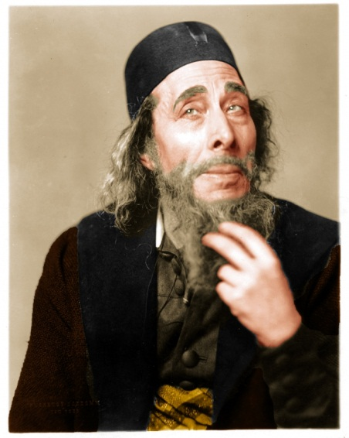
Stereotypes
II. Key concepts
Jew – good at business, stingy, exploitative
Aryan – athletic, upright
Chinese – industrious, dirty
Malay – charming, courteous, lazy
Implications – not physical traits BUT behavioural traits. Yet, talked about as if genetically inherited;
assumption that no variation in behaviour is possible
Notes:
Problematic assumptions about traits in the society

Slide 16
II. Key concepts
PREJUDICE
An attitude that judges a person on his or her group’s real or imagined characteristics
Can foster feelings of dislike, suspicion, and hatred
DISCRIMINATION
Unfair treatment of people because of their group membership
Actions, behaviours of differential treatment
More negative than positive
Individual/institutional discrimination
Racism – involves both attitude and behaviour
Notes:
Stereotype leads to prejudice and discrimination, and thus leads to racism

Slide 17
Stereotypes imply negative or positive evaluations of social groups
Prejudice
(what people think/ judgement)
Discrimination
(what people do/ behaviour)

Slide 18
Racism
II. Key concepts
Racism – a belief system or ideology used to justify the superiority of one race over another based on physical characteristics
Indicates group inferiority and justifies discrimination (p.291)

Slide 19
Racism
II. Key concepts
Individual racism – the belief that certain groups are superior to others as exhibited by face-to-face interactions
Institutional racism – superiority of certain groups over others which is promoted by the day-to-day practices, policies and procedures of social institutions
Examples
Individual racism: use of derogatory names such as ‘nigger’ or ‘chink’
Institutional racism (p.291): Police car searches, mortgage applications
Notes:
Institutional Racism- E.g Coke discrimination against racial groups. “Chink” towards Chinese, underlying tone of racism. Particular group of people being targeted. Profiling towards a certain type of people.

Slide 20
III. Racial/Ethnic violence
Genocide refers to systematic efforts of a dominant group to destroy a minority group
Rwanda – Tutsis vs Hutus (p.307-309)
Holocaust – Nazi Germany
Notes:
Extreme form of racism.

Slide 21
IV. Theories of Race & Ethnicity
FUNCTIONALIST PERSPECTIVE
Ecological Theory (p.292)
CONFLICT PERSPECTIVE
Internal Colonialism (p.293; 296/7)
CONFLICT PERSPECTIVE
Split Labour Market (p.293; 297/8)

Slide 22
IV. Theories of Race & Ethnicity
1. Ecological Theory (p.292)
Explores the processes by which conflict between racial or ethnic groups develops and is resolved
Robert Park’s (1914) cyclical model
5 stages
Invasion
Resistance
Competition
Accommodation & Cooperation- work out an understanding
Assimilation
Notes:
When different racial groups come together, how do they resolve conflicts. Invasion: May be terrorist. Resistance: tries to drive them out.

Slide 23
IV. Theories of Race & Ethnicity
1. Ecological Theory (p.292)
Example - Whites of European origin such as Italian American, Irish American, German American stopped thinking of themselves in these terms ‘Whites’
Assimilation – blending in with majority group
Notes:
Stability in the end.

Slide 24
IV. Theories of Race & Ethnicity
1. Ecological Theory (p.292)
Critique #1 – lack of attention on social-structural conditions that hinder assimilation. E.g. ignoring the role of the state in ethnic relations
Critique #2 – assumption that all societies go through the stages as naturalistic or inevitable
Critique #3 – notions of assimilation or accommodation not clearly spelt out

Slide 25
IV. Theories of Race & Ethnicity
2. Internal Colonialism (p.293, 296-297)
Derived from External Colonialism
Prevention of assimilation through segregation
Example – African Americans
3. Split Labour Market (p.293, 297-298)
Low-wage workers vs high-wage workers compete for same jobs → resentment and conflict
Racist attitudes develop/get reinforced
Example – Chinese Americans
Notes:
Segregation can be through housing, employment. Groups are kept apart from one another.

Slide 26
V. Race in Singapore
PuruShotam (1998) ‘Disciplining Difference: Race in Singapore’
Main arguments
Substantiation
Conclusion

Slide 27
V. Race in Singapore
Introduction
CMIO caricatures
NDP
School
Forms
‘Where have these four names, that powerfully frame all of us in contemporary Singapore, come from?’ (p.54)
‘deeply rooted in our colonial past’
Data source: Census Reports, 1871-1957
Notes:
Trace the racial categories to the colonial past.

Slide 28
V. Race in Singapore
‘Who of these highly variegated groups of people, with their multiple memberships, were selectively named?’
‘By whom were they named?’
‘What are the larger socio-historical significances of this, if any?’
‘What meanings did these names harbour, notionally and/or specifically?’

Slide 29
V. Race in Singapore
Main arguments
Race as a social construct
Change over time
Disciplining Difference

Slide 30
V. Race in Singapore
Change over time
1871 census (p.61)
Europeans & Americans
Armenians
Jews
Eurasians
Abyssinians
Achinese
Africans
Andamanese
Arabs
Bengalis
Boyanese
Bugis
Burmese
Chinese
Cochin Chinese
Dyaks
Hindoos
Japanese
Javanese
Jaweepekans
Klings
Malays
Manilamen
Mantras
Parsees
Persians
Siamese
Singhalese
Notes:
More than 40 racial category. They may not be really races, but nationality.

Slide 31
V. Race in Singapore
1881 census (p.61-63)
47 peoples distinguished, reclassified under 6 main categories
Europeans & Americans
Eurasians
Chinese
Malays and Other Natives of the Archipelago
Tamils and Other Natives of India
Other Nationalities
Notes:
Arbitrary compared to the biological concept

Slide 32
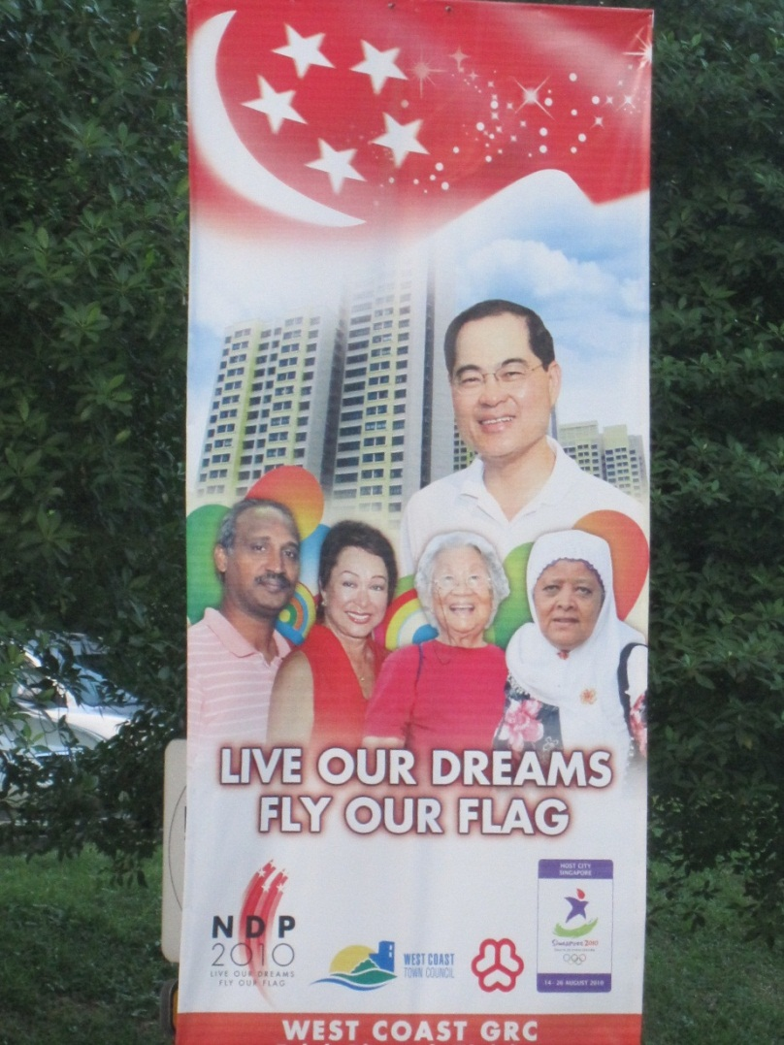
V. Race in Singapore
Present-day racial classification
Chinese
Malay
Indian
Others
Double-barrelled (2010/2011)

Slide 33
V. Race in Singapore
Substantiation
Reference to nation, place, language, occupational niches
Nation - ‘Europeans’ shortened from ‘Europeans and Americans’, included Austria, Belgium, Holland, France, Turkey etc (p.69)
Place/province – under ‘Chinese’ category, new additions were included comprising Hokchiu, Hokchia, Kwongsai, and Chinese from Shanghai, Beijing, etc (p.72)
Notes:
Sweep into categories.

Slide 34
V. Race in Singapore
Disciplining Difference
Homogenisation – Malays, Buginese, Baweanese and so forth subsumed under the grouping of ‘Malays’; the word ‘Malays’ became the condensed race name for all the others from Peninsula Malaya and the surrounding archipelago; Chinese-China (p.81)
Contributions and Ranking – Chinese way ahead vs Malay peasant (p.84, 87)
Mother-tongue – linked to place of origin; ‘language is the vehicle by which one knows one’s roots, one’s culture’ (p.89)
Notes:
Legacy of colonial government. Making a hierarchy out of different races as u differentiate people.

Slide 35
II. Key concepts
III. Racial/Ethnic violence
IV. Theories
V. Singapore case study
I. Problematising Race & Ethnicity
Distinguishing between ‘race’ & ‘ethnicity’; minority group; stereotype; prejudice; discrimination; racism
Critique (problems); Out of Africa theory; no universal definition; inconsistent characteristics
Genocide; Rwanda; Holocaust
Ecological Theory; Internal Colonialism; Split Labour Market
CMIO; social construct; disciplining difference

